Slide 1


Lecture Topic 10: Return and Risk
Asset Pricing Model - CAPM
Presentation to Cox Business Students
FINA 3320: Financial Management
Presentation to Cox MBA Students
FINA 6214: International Financial Markets

Slide 2
Return and Risk
The Capital Asset Pricing Model (CAPM)

Slide 3
What is Investment Risk
Risk, in general, refers to the chance that some unfavorable event will occur
Investment risk pertains to the probability of realized (actual) returns being less than expected returns
  The greater the chance of low or negative returns, the riskier the investment

Slide 4
Types of Risk
Stand-alone risk
  Riskiness of an asset held in isolation
Portfolio risk
  Riskiness of an asset held as one of a number of assets in a portfolio
  In a portfolio context, risk can be divided into two components
    Diversifiable (firm-specific) risk
    Market (non-diversifiable) risk

Slide 5
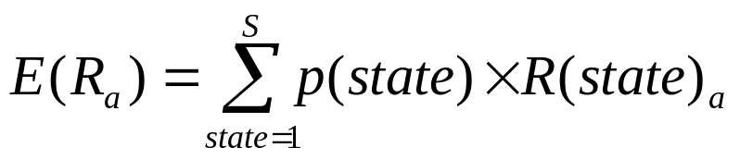
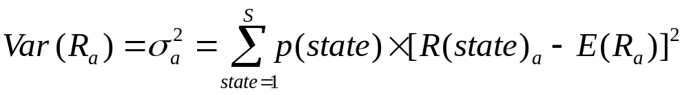
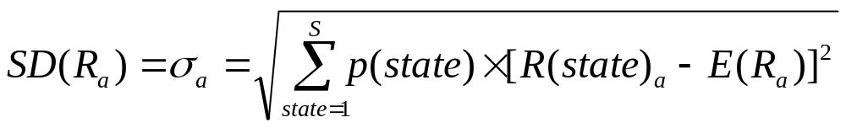
Individual Securities
The characteristics of individual securities that are of interest are the:
  Expected Return: Return on a risky asset expected in the future
  Variance and Standard Deviation: Measures of dispersion of an asset’s returns around its expected, or mean, return

Slide 6
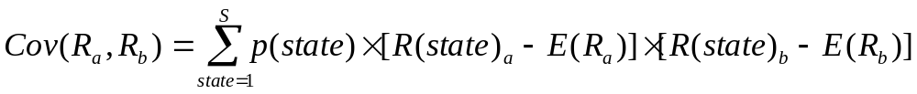
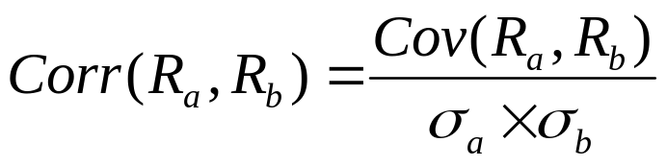
Individual Securities
The characteristics of individual securities that are of interest are the:
  Covariance and Correlation (to another security or index): statistics measuring the interrelationship between two securities

Slide 7
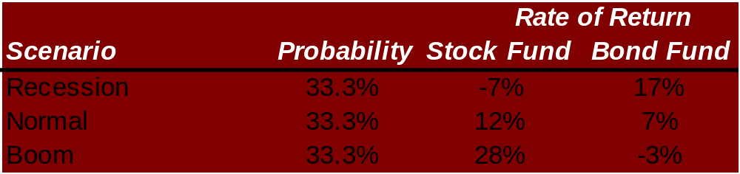
Expected Return, Variance, Standard Deviation, and Covariance
Consider the following two risky asset world
  There is a 1/3 chance of each state of the economy
  The only assets are a stock fund and a bond fund

Slide 8
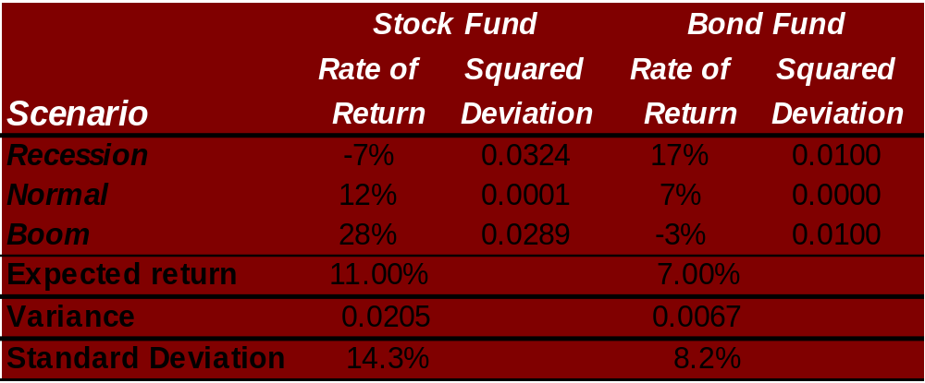
Expected Return

Slide 9

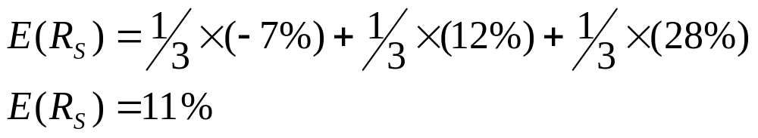
Expected Return

Slide 10
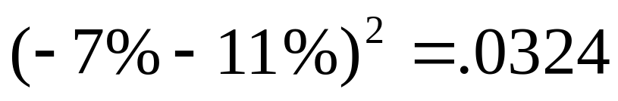
Variance

Slide 11
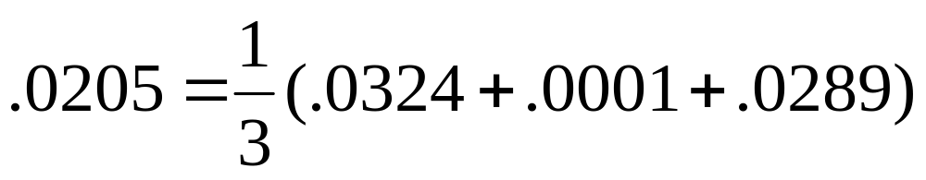
Variance

Slide 12
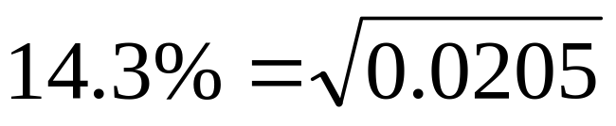
Standard Deviation

Slide 13
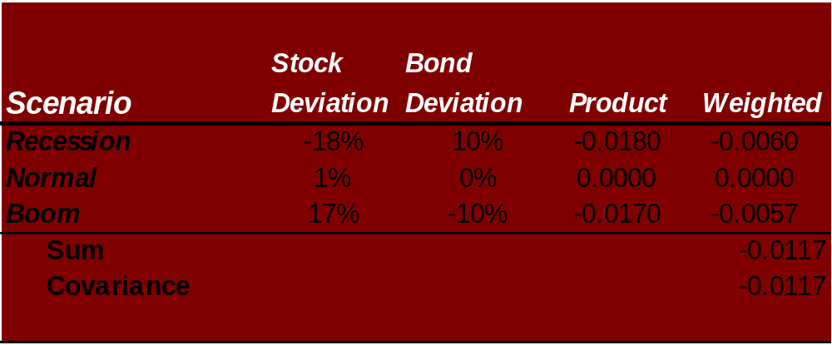
Covariance
  Deviation compares return in each state to the expected return
  Weighted takes the product of the deviations multiplied by the probability of that state

Slide 14
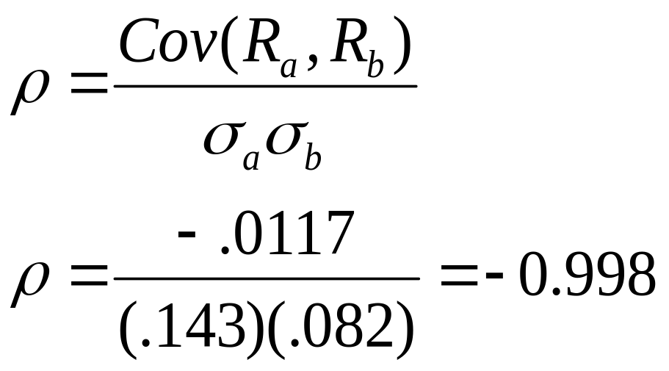
Correlation

Slide 15
Return and Risk for Portfolios
  Note that stocks have a higher expected return than bonds and higher risk
  Now turn to the risk-return tradeoff of a portfolio that is 50% invested in bonds and 50% invested in stocks

Slide 16
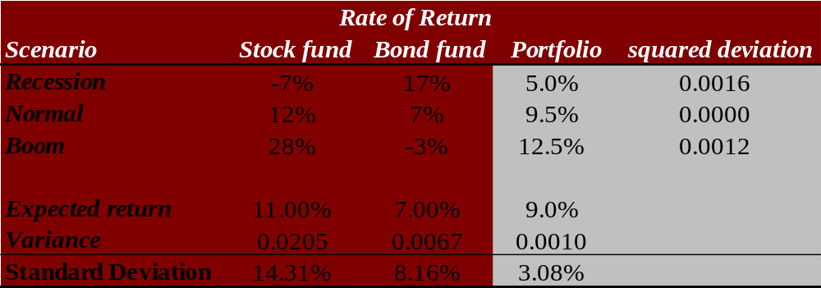
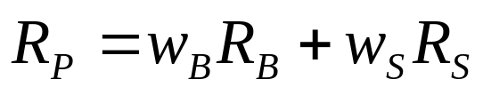
Portfolios
  The rate of return on the portfolio is a weighted average of the returns on the stocks and bonds in the portfolio

Slide 17



Portfolios
  The expected rate of return on the portfolio is a weighted average of the expected returns on the securities in the portfolio

Slide 18

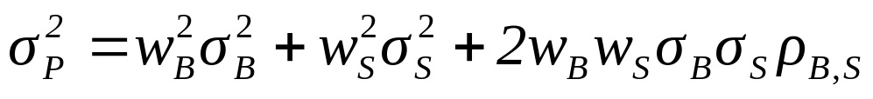
Portfolios
  The variance of the rate of return on the two risky asset portfolio is:

Slide 19
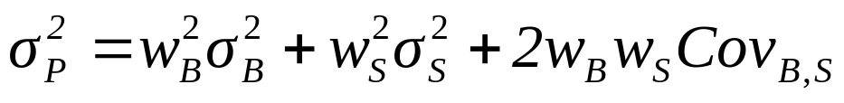
Portfolios
  The variance of the rate of return on the two risky asset portfolio is:

Slide 20
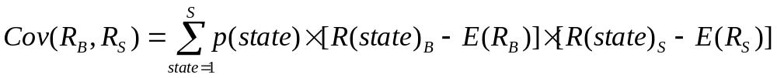

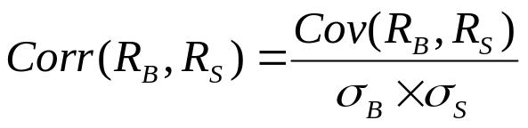
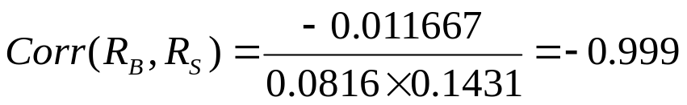
Portfolios
Covariance
Correlation

Slide 21
Portfolios
  Observe the decrease risk that diversification offers
    Particularly when the two assets are almost perfectly negatively correlated!!!
  An equally weighted portfolio (50% in stocks and 50% in bonds) has less risk than either stocks or bonds held in isolation

Slide 22
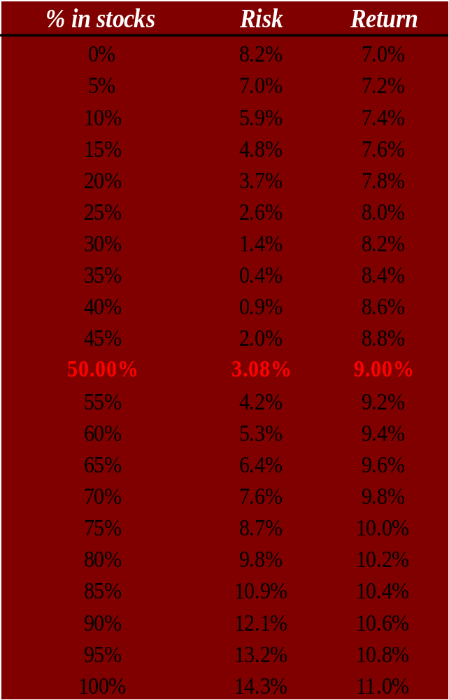
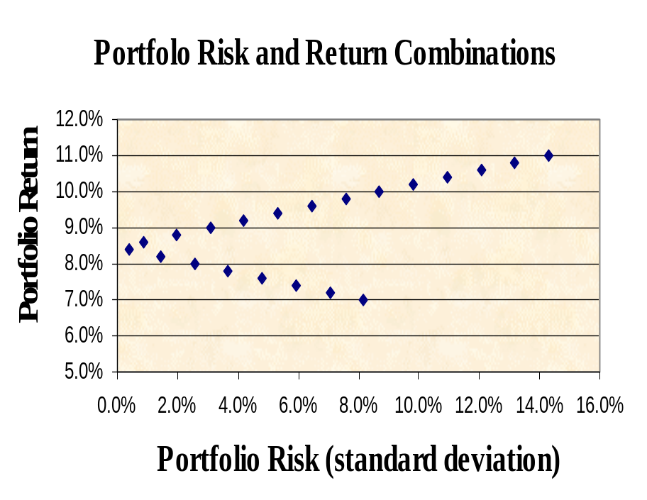
The Efficient Set for Two Assets
100% stocks
100% bonds
We can consider other portfolio weights besides 50% in stocks and 50% in bonds …

Slide 23
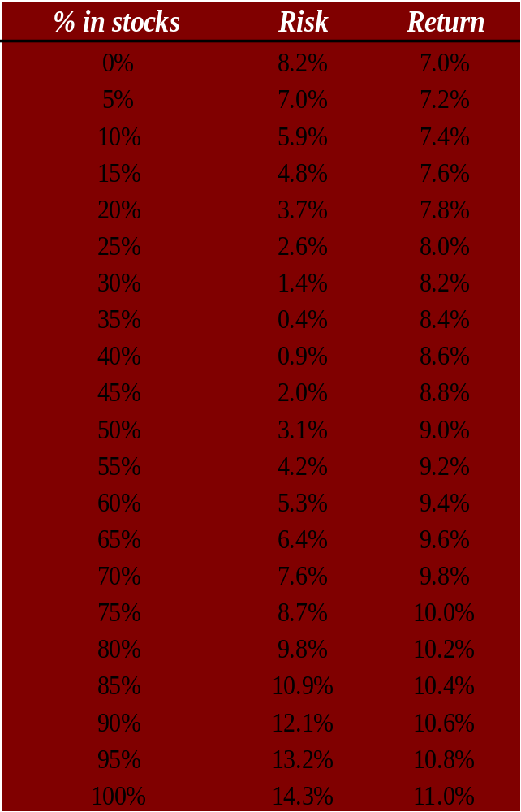
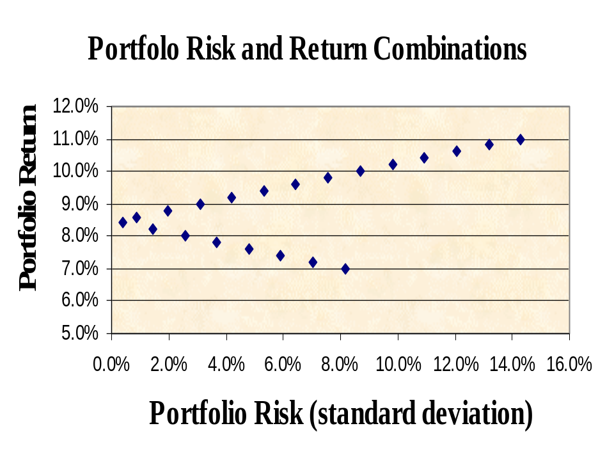
The Efficient Set for Two Assets
100% stocks
100% bonds
Note that some portfolios are “better” than others. They have higher returns for the same level of risk or less.

Slide 24

Portfolios with Various Correlations
    Relationship depends on correlation coefficient
    If ρ = +1.0, no risk reduction is possible
    If ρ = -1.0, complete risk reduction is possible
return
ρ = -1.0
100% stocks
ρ = 1.0
ρ = 0.2
100% bonds
σ_{P}

Slide 25
The Efficient Set for Many Securities
  Consider a world with many risky assets
  We can still identify the opportunity set of risk-return combinations of various portfolios
return
Individual Assets
σ_{P}

Slide 26
The Efficient Set for Many Securities
  The section of the opportunity set above the minimum variance portfolio is the efficient frontier
return
efficient frontier
minimum variance portfolio
Individual Assets
σ_{P}

Slide 27
Stand-alone vs. Portfolio Risk
Stand-alone risk
  Measured by the dispersion of returns about the mean (standard deviation) of an individual asset and is relevant only for assets held in isolation
Portfolio risk
  The risk of an asset when held in a portfolio
  In portfolio context, risk can be divided into:
    Diversifiable risk (also called firm-specific, unique, or unsystematic)
    Non-diversifiable risk (also called market or systematic)
  As long as correlation coefficient < 1, portfolio risk is lower than stand-alone risk

Slide 28
Diversification and Portfolio Risk
Diversification can substantially reduce the variability of returns without an equivalent reduction in expected returns
  This reduction in risk arises because worse than expected returns from one asset are offset by better than expected returns from another asset
  However, there is a minimum level of risk that cannot be diversified away, and that is the systematic portion

Slide 29
Portfolio Risk and Number of Stocks
  In a large portfolio, the variance terms are effectively diversified away, but the covariance terms are not!
σ
Diversifiable Risk; Nonsystematic Risk; Firm Specific Risk; Unique Risk
Portfolio risk
Nondiversifiable risk; Systematic Risk; Market Risk
n

Slide 30
What is Diversifiable Risk?
Caused by company specific events (e.g., lawsuits, strikes, winning or losing major contracts, etc.)
  Risk factors that affect a limited number of assets
  Also known as unique risk or unsystematic risk
  Risk that can be eliminated by combining assets into a portfolio
    Effects of such events on a portfolio can be eliminated by diversification
  If we hold only one asset, or assets in the same industry, then we are exposing ourselves to risk that we could diversify away

Slide 31
What is Market Risk?
Stems from such external events as war, inflation, recession, changes in GDP and/or interest rates
  Risk factors that affect a large number of assets
  Also known as non-diversifiable risk or systematic risk
    Known as systematic risk since it shows the degree to which a stock moves with other stocks
  Because all firms are effected simultaneously by these factors, market risk cannot be eliminated by combining assets into a portfolio
    Effects of such factors on a portfolio cannot be eliminated by diversification

Slide 32
What is Total Risk?
Total risk = systematic risk + unsystematic risk
  The standard deviation of returns of an individual asset is a measure of total risk
  For well-diversified portfolios, unsystematic risk is very small
  Consequently, the total risk for a diversified portfolio is essentially equivalent to the systematic risk

Slide 33
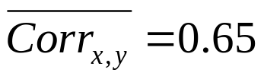



Stock Prices and Information
Actual (realized) return = expected return + unexpected return (surprise)
  Surprise is risk of investment (what we couldn’t forecast prior to buying the asset)
General diversification information
  Most stocks are positively correlated:
  Average stand-alone risk:
  Average portfolio risk:
  Combining stocks in a portfolio lowers risk
    Except when :

Slide 34
What would happen to the riskiness of a 1 stock portfolio as more randomly selected stocks were added
The standard deviation of the portfolio would decrease because the added stocks would not be perfectly correlated

Slide 35
Standard Deviations of Annual Portfolio Returns
Ratio of Portfolio
Average Standard Standard Deviation to
Number of Stocks Deviation of Annual Standard Deviation
in Portfolio Portfolio Returns of a Single Stock
1 49.24% 1.00
10 23.93% 0.49
50 20.20% 0.41
100 19.69% 0.40
300 19.34% 0.39
500 19.27% 0.39
1,000 19.21% 0.39
These figures are from Table 1 in Meir Statman, “How Many Stocks Make a Diversified Portfolio?” Journal of Financial and Quantitative Analysis 22 (September 1987), pp. 353–64. They were derived from E. J. Elton and M. J. Gruber, “Risk Reduction and Portfolio Size: An Analytic Solution,” Journal of Business 50 (October 1977), pp. 415–37.

Slide 36
Risk and the Sensible Investor
If you chose to hold a one-stock portfolio and thus are exposed to more risk than diversified investors, would you be compensated for all the risk that you bear?

Slide 37
Risk and the Sensible Investor
  NO!
  Stand-alone risk (as measured by individual stock’s σ) is not important to a well-diversified investor since it can be reduced through diversification
  Since diversifiable risk can be easily eliminated, rational investors will do so
    Rational risk averse investors are concerned with portfolio risk σ_{P}, which is based on market risk, and the contribution of a security to the risk of the entire portfolio
  In equilibrium, there can be only one price, or return, for a given security
    If majority of investors are diversified and they determine prices, then no compensation can be earned for the additional risk of a one-stock portfolio

Slide 38
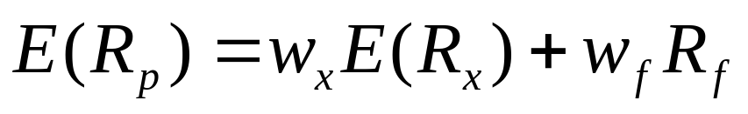
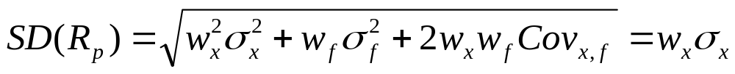
Risk Free Assets
So far we have examined portfolios of risky assets…
What happens if one of the assets in our portfolio is risk free, i.e., σ_{f} = 0?
Or

Slide 39




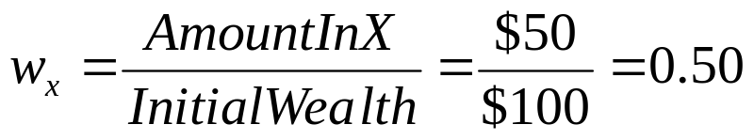
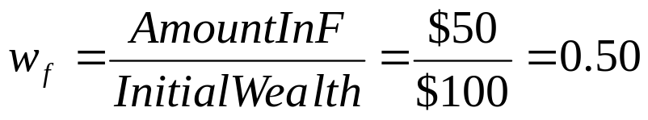

Risk Free Assets
Assume there is a risky asset, x, and a risk free asset, f
    Risky Asset:
    Risk Free Asset:
  You have $100, you put $50 in x and $50 in f (i.e., lending $50 at the risk free rate)
  The weights are:

Slide 40
Optimal Portfolio with a Risk-Free Asset
  In addition to stocks and bonds, consider a world that also has risk-free securities, e.g., T-bills
  Now investors can allocate their money across the Treasury securities and a balanced mutual fund
return
CML
100% stocks
Balanced fund
R_{f}
100% bonds
σ

Slide 41

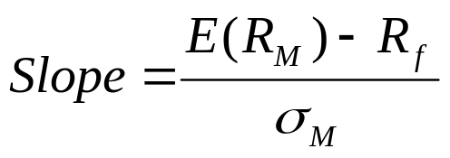




Riskless Borrowing and Lending
The Capital Market Line (CML)
  Expected Portfolio Return:
  Slope = Market Price of Risk:
  Any portfolio on CML is a combination of M and f
  If we invest in the risk-free asset, f, and in M:
  If we borrow money at the risk-free rate and invest in M

Slide 42
Riskless Borrowing and Lending
The Capital Market Line (CML)
  With a risk-free asset available and the efficient frontier identified, we choose the capital allocation line with the steepest slope
  This is the Capital Market Line (CML)
return
CML
efficient frontier
R_{f}
σ_{P}

Slide 43
Market Equilibrium
  With the optimal capital allocation line (i.e., the CML) identified, all investors choose a point along the line
    i.e., some combination of the risk-free asset and the market portfolio, M
  In a world with homogeneous expectations, M is the same for all investors
return
CML
efficient frontier
M
R_{f}
σ_{P}

Slide 44
Market Equilibrium
  Where the investor chooses along the Capital Market Line (CML) depends on her risk tolerance
  The important point is that all investors have the same CML
return
CML
100% stocks
Balanced fund
R_{f}
100% bonds
σ_{P}

Slide 45
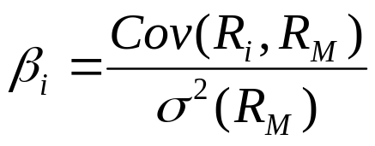
The Systematic Risk Principal
Risk when holding the Market Portfolio, M
  Researchers have shown that the best measure of the risk of a security in a large portfolio is the beta (β) of the security
  Beta measures the responsiveness of a security to movements in the market portfolio, i.e., systematic risk
    The reward for bearing risk depends only upon systematic risk since unsystematic risk can be diversified away

Slide 46
Estimating β with Regression
Security Returns
Characteristic Line
Slope = b_{i}
Slope = β_{i}
Return on market %
R_{i} = α _{i} + β_{i}R_{m} + e_{i}

Slide 47
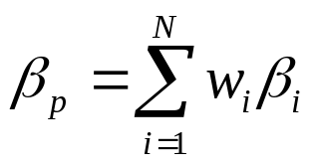
Portfolio Betas (β_{p})
Portfolio Betas
  While portfolio variance is not equal to a simple weighted sum of individual security variances, portfolio betas are equal to the weighted sum of individual security betas
    Where w is the proportion of security i’s market value to that of the entire portfolio, and N is the number of securities in the portfolio

Slide 48
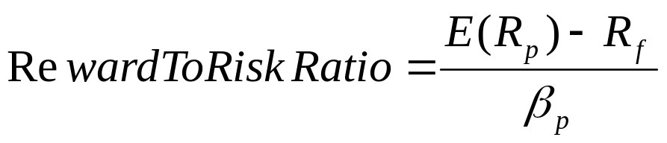
Relationship between Risk and Expected Return (CAPM)
Beta and the Risk Premium
    A risk-free asset has a beta of zero
    When a risky asset is combined with a risk-free asset, the resulting portfolio expected return is a weighted sum of their expected returns and the portfolio beta is the weighted sum of their betas
Reward-to-Risk Ratio
    We can vary the amount invested in each type of asset and get an idea of the relationship between portfolio expected return and portfolio beta

Slide 49
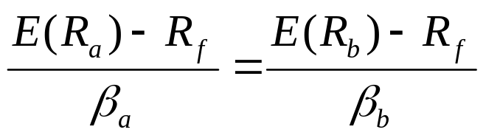
Relationship between Risk and Expected Return (CAPM)
What happens if two assets have different reward-to-risk ratios?
    Since systematic risk is all that matters in determining expected return, the reward-to-risk ratio must be the same for all assets and portfolios in equilibrium
      If not, investors would only buy the assets (or portfolios) that offer a higher reward-to-risk ratio
    Because the reward-to-risk ratio is the same for all assets, it must hold for the risk-free asset as well as for the market portfolio
    Result:

Slide 50
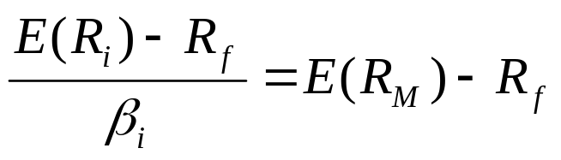
Relationship between Risk and Expected Return (CAPM)
The Security Market Line (SML)
  The security market line is the line which gives the expected return – systematic risk (beta) combinations of assets in a well functioning, active financial market
    In an active, competitive market in which only systematic risk affects expected return, the reward-to-risk ratio must be the same for all assets in the market
    The slope of the SML is the difference between the expected return on the market portfolio and the risk-free rate (i.e., the market risk premium)
    Result:

Slide 51
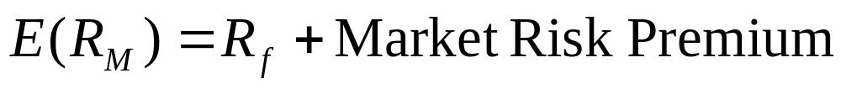
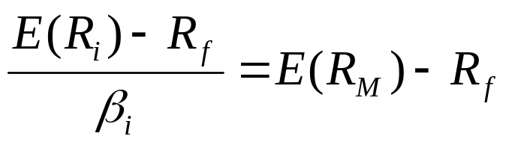
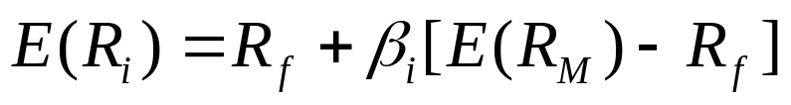
Relationship between Risk and Expected Return (CAPM)
Expected Return on the Market
Expected Return on an individual security
  Or
    This applies to individual securities held within well-diversified portfolios
Market Risk Premium

Slide 52


Relationship between Risk and Expected Return (CAPM)
Capital Asset Pricing Model (CAPM)
Expected return
β_{M} =1.0
β

Slide 53

The Capital Asset Pricing Model
The Capital Asset Pricing Model (CAPM)
  An equilibrium model of the relationship between risk and required return on assets in a diversified portfolio
  What determines an asset’s expected return?
    The risk-free rate: the pure time value of money
    The market risk premium: the reward for bearing systematic risk
    The beta coefficient: a measure of the amount of systematic risk present in a particular asset
  The CAPM:

Slide 54
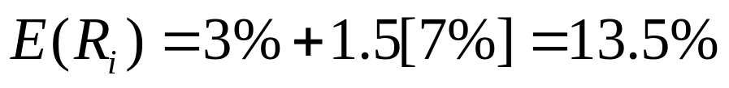
The Capital Asset Pricing Model
Example: Capital Asset Pricing Model
  Suppose a stock has 1.5 times the systematic risk as the market portfolio
  The risk-free rate as measured by the T-bill rate is 3% and the expected risk premium on the market portfolio is 7%
  What is the stock’s expected return according to the CAPM?

Slide 55
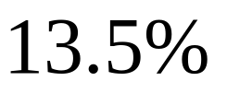
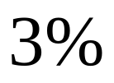
The Capital Asset Pricing Model
Example: Capital Asset Pricing Model
Expected return
1.5
β

Slide 56
Summary of Risk and Return
I. Total risk: the variance (or the standard deviation) of an individual, stand-alone asset’s return
II. Total return: the expected return + the unexpected return (surprise)
III. Systematic and unsystematic risks
Systematic risks are unanticipated events that affect almost all assets to some degree
Unsystematic risks are unanticipated events that affect single assets or small groups of assets
IV. The effect of diversification: the elimination of unsystematic risk via the combination of assets into a portfolio
V. The systematic risk principle and beta: the reward for bearing risk depends only on its level of systematic risk
VI. The reward-to-risk ratio: the ratio of an asset’s risk premium to its beta
VII. The capital asset pricing model: E(R_{i}) = R_{f} + [E(R_{M}) - R_{f}] × β_{i}

Slide 57
Thank You!
Charles B. (Chip) Ruscher, PhD
Department of Finance and Business Economics

